Slide 1
On-Boarding for Success: Boards Helping New Camp Directors Thrive

Slide 2
About UpStart
UpStart exists to inspire and empower leaders to dream, build, and grow bold initiatives that enhance the vitality of Jewish life.

Slide 3
Goals
Understand the need for a structured on-boarding process for new directors
Understand the unique and important role of lay leaders in supporting new directors.
Learn concrete skills for aligning expectations, creating systems of accountability, and maintaining excellence while driving change.

Slide 4
Framing Questions
What elements of “good management” also support good transitions?
What makes it hard for founder driven organizations to transition to new leadership?
How can funders, board members, staff, and executive directors support successful transition management?

Slide 5
True or False?
Good succession planning takes 2-3 years.
In order for a camp to succeed, the founder must stick around for at least eight years.
50% of executive directors hired following a founder or long-term director leave within two years.
Camps have a realistic sense of the time, effort, and $$ required to attract and retain the next leader.

Slide 6
What Does the Future Hold?
For your camp?
For your Camp Director?

Slide 7
Pair Share
In pairs, think out loud about where you think your camp and its current leader might be in five years.
There won’t be any mandatory sharing on this question ☺

Slide 8
Camp
Growing
"Right-sized”, stable
Merge with another camp
Sunset
????

Slide 9
Camp Director
Continue to serve as lead staff person
Bring in someone else in Camp Director role and shift to a different role
Bring in someone else in Camp Director role and shift to the board
Transition out
?????

Slide 10
Should I Stay or Should I Go? a conversation that Camp Directors should have with themselves and their board regularly . . .
What does the organization need now?
Do I have the energy and appetite for the next phase?
Do I have the skills for the next phase?
Can I build and lead a team for the next phase?
Does the work of the next phase make the best use of me and my gifts?

Slide 11
Taking the Long View
2-3 year time horizon, more for a founder or long-term leader
View it as an organizational function, not an episode

Slide 12
Who Transitions?
Leadership AND Camp
Transitions are also likely to be times of organizational change, culture shift, and re-structuring.

Slide 13
Transition Types
Sustaining Success
Turnaround
Underperforming
Emergency
Founder/Long-Term Leader Departure
Startup (hire first Camp Director)

Slide 14
Case Studies
We will divide into three teams.
Each team will examine one case and talk through the discussion questions at the end.
You are serving as consultants to the organization. What do you recommend?
Teamwork 10 min.
Report out 10 min.

Slide 15
Best Practices in Succession Planning
Move from founder driven to stakeholder driven.
Create leadership pipelines.
Craft an emergency succession plan.
Build leadership capacity throughout the organization (staff and board).
Recruit a strong #2.
Set term limits for the board and intentionally build board leadership.

Slide 16
Best Practices Cont.
Move from founder-centric to shared leadership / distributive leadership model.
Codify vision and core values.
Articulate contingency plans.
Practice – sabbaticals, leaves of absence.
Formal job descriptions and regular performance reviews.

Slide 17
Best Practices in Transition Management
Know your organizational moment.
Good process goes beyond “find and replace”.
Strategic thinking before and after – includes sustainability planning.
Determine roles for founder/exiting Camp Director – hands on, on-call, hands-off – set boundaries, monitor.

Slide 18
Best Practices Cont.
Don’t hire “in opposition”.
Manage internal candidates carefully.
Consider an interim.
Have a plan for the lame duck period.
Culture and values fit are as important as other criteria.
Transition includes successful onboarding of new Camp Director– support, access, good will.

Slide 19
Prepare, Search, Thrive
Assess
Educate (stakeholders, funders, partners)
Interim (?)
Search
Out-board (knowledge transfer, next role, compensation, boundaries)
On-Board
Support
Assess

Slide 20
When to have an Interim?
Leave of absence (anticipated, emergency)
Quick departure
Turnaround
Organizational decline
Dominant leader transition
Dissolution

Slide 21
Transition Committee
Board Committee helps to steer process prior, during, and post-transition.
Should include current Chair and Rising Chair.
Holds three critical roles post-hire:
On-board
Support
Assess

Slide 22
Four working groups:
Listening Tour – design a listening tour for a new Camp Director. Who should s/he speak to in order to get a full picture of camp and its stakeholders?
Board Support System – how can the board best support a new Camp Director?
Functions – design a process to get the Camp Director up to speed on program, operations, and facility.
Assessment – what might be reasonable benchmarks for a new Camp Director for the first 90 days?

Slide 23
Founder Quiz 1 Point for Each True Item:
The board is comprised exclusively of close friends and colleagues of the founder.
Staff see themselves as working for the founder, not the organization.
The board defers to the founder on most major decisions.
The board does not raise issues it feels the founder might be uncomfortable with.
Camp is averse to systemized planning.

Slide 24
1 Point for Each True Item:
There are no accountability structures. The Camp Director does not have a regular performance review or clear deliverables.
The founder is seen as the driving force in the organization.
Everyone silently fears the departure of the founder.
Donors seem more attracted to the founder than they are to the camp.
Staff do not feel that they can voice dissent or ideas that would be unpopular with the founder.
The board cheerleads, but it does not lead.
When there is a crisis, stakeholders look to the founder for answers.

Slide 25
Success!
New executive is able to meet current and future needs.
Right fit for organization’s values and culture.
Meets and exceeds expectations (goals, benchmarks).
Remains in position three years or more.

Slide 26
Commitments
Identify 3 clear, actionable, and measurable things your organization can do over the next three months to:
Reduce exposure to founder's syndrome
Prepare for and manage transitions
Successfully on-board a new Camp Director

Slide 27
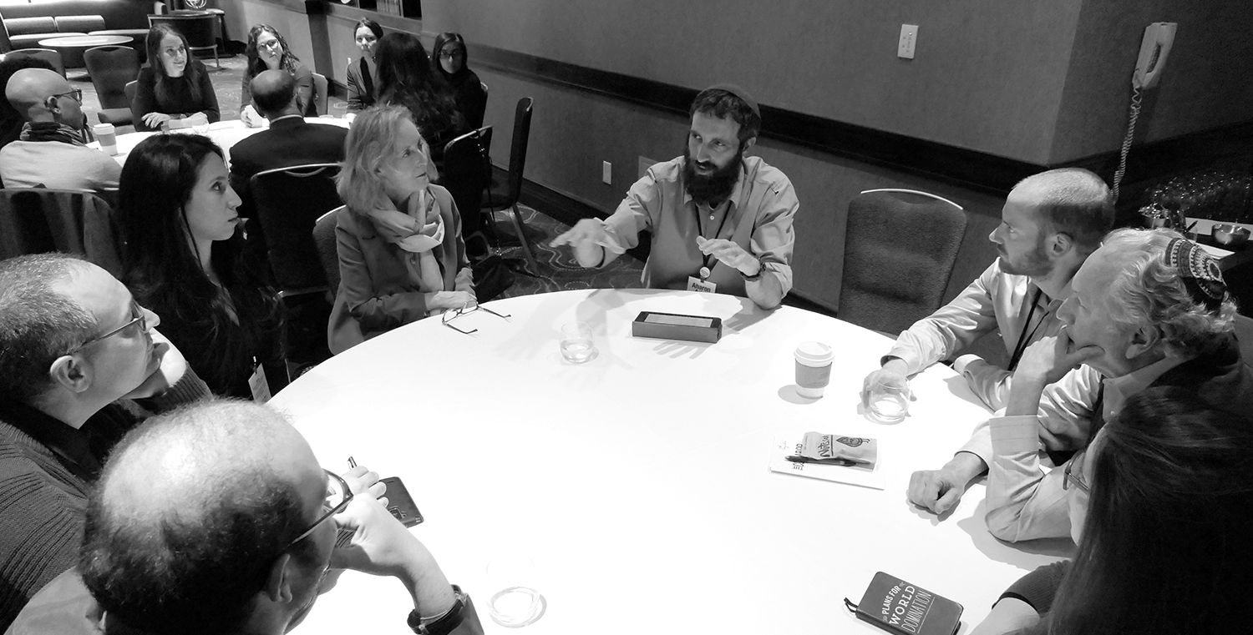
Thank You!

