Slide 1
PRAYING THAT TEFILOT ARE SUCCESSFUL AT CAMP…
CHERYL MAGEN
SHALOM ORZACH

Slide 2
GOALS
Take time now and think hard about what you want your community to get out of prayer experiences.
Take those thoughts and turn them into actionable steps.
Begin to think about ways to get staff prepared and engaged.
Consider the culture in your camp and plan for for enhancement or improvement in the best way.

Slide 3
IMAGINE DREAM ENVISION
List your goals. GOALS = what is the ideal situation for prayer in your setting?
On Sept. 15th when you look back at the summer, what do you want to be able to say??

Slide 4
PAIR AND SHARE

Slide 5
SMALL GROUPS
PLACES PRAYER HAPPENS?
WHY DO WE PRAY AT CAMP?
VALUES WE WANT TO TRANSMIT?

Slide 6
PREDICTORS OF PRAYER SUCCESS
Cannot teach meaning to all tefillot in one summer
Different age groups need different amounts of prayer infusion
Day 1 is not day 50
Prayer is: skill based, emotionally charged, takes constant and consistent repetition
God Talk for staff
create community around prayer moments
ritualize what happens so there is consistency and predictability
be intentional about creating magical moments (even if it means being spontaneous)

Slide 7
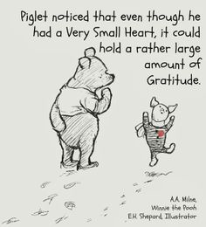
Use as many modalities as possible
Expand when and where prayer happens
Someone has to be the keeper of the prayer mission – a visionary who is also a mover-shaker
Need a Team of pray-ers. God Squad.
Use the language of prayer in everything you do: praise, gratitude, hopes

Slide 8
INTENTION
STAFF
ROLE MODELS

Slide 9
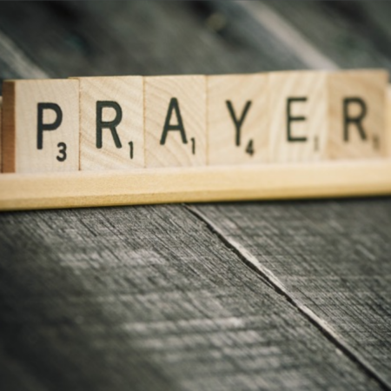
IS THERE A DIFFERENCE…
BETWEEN SINGING SONGS AND PRAYING

Slide 10
CREATE PRAYERS BASED ON THEIR EXPERIENCES
Incorporate Israeli shlichim
Invite support staff
Expand the community

Slide 11
TEFILLAT HADERECH – PRAYER FOR A SAFE JOURNEY
May it be Your will, God, our God and the God of our ancestors, that You should lead us in peace and direct our steps in peace, and guide us in peace, and support us in peace, and cause us to reach our destination in life, joy, and peace (If one intends to return immediately, one adds: and return us in peace). Save us from every enemy and ambush, from robbers and wild beasts on the trip, and from all kinds of punishments that rage and come to the world. May You confer blessing upon the work of our hands and grant me grace, kindness, and mercy in Your eyes and in the eyes of all who see us, and bestow upon us abundant kindness and hearken to the voice of our prayer, for You hear the prayers of all. Blessed are You God, who listens to prayer.
יְהִי רָצוֹן מִלְפָנֶיךָ יְ-יָ אֱ-לֹהֵינוּ וֵא-לֹהֵי אֲבוֹתֵינוּ. שֶׁתּוֹלִיכֵנוּ לְשָׁלוֹם. וְתַצְעִידֵנוּ לְשָׁלוֹם. וְתַדְרִיכֵנוּ לְשָׁלוֹם. ותסמיכנוּ לְשָׁלוֹם. והגיענוּ לִמְחוֹז חֶפְצֵנוּ לְחַיִּים וּלְשִׂמְחָה וּלְשָׁלוֹם. (ואם דעתו לחזור מיד אומר: וְתַחֲזִירֵנוּ לְשָׁלוֹם). וְתַצִילֵנוּ מִכַּף כָּל-אוֹיֵב וְאוֹרֵב וְלִסְטִים וְחַיּוֹת רָעוֹת בַּדֶּרֶך. וּמִכָּל פורעניות הַמִּתְרַגְּשׁוֹת וּבָאוֹת לָעוֹלָם. וְתִשְׁלַח בְּרָכָה בְּכָל מַעֲשֵׂה יָדֵינוּ. וְתִתְּנֵו לְחֵן וּלְחֶסֶד וּלְרַחֲמִים בְּעֵינֶיךָ וּבְעֵינֵי כָל רוֹאֵינוּ. וְתִגְמְלֵנוּ חֲסָדִים טוֹבִים. וְתִשְׁמַע קוֹל תפילתנוּ. כִּי אַתָּה שׁוֹמֵעַ תְּפִלַת כָּל פֶּה: בָּרוּךְ אַתָּה יְ-יָ שׁוֹמֵעַ תְּפִלָה:

Slide 12
WRITE A PRAYER FOR A SAFE JOURNEY THIS SUMMER…
Think about what the challenges are in camp
What are positive, supportive words for you to hear as a leader?
Use the traditional format or make your own
Hebrew, English, ASL, any language

Slide 13
THANK YOU!
Our prayer for you:
God, please watch over this group of leaders who dedicate their lives to enriching others in positive, joyful Judaism. Give them the strength they need to reach their prayer goals for this summer and let the staff members be positive about change. Keep the camper’s minds open to new ideas and keep staff full of creative energy and positivity.

