Slide 1
Transgender Inclusion: Beyond the (Cis)Gender Binary

Slide 2
Goals for Today
Discuss and understand how gender operates in our society.
Develop a better understanding about both the unique needs of transgender and non-binary individuals and their families, as well as the challenges they face in daily life.
Leave with best practices and strategies for making your camp more inclusive.

Slide 3
Gender Boxes
Boy/Man
Girl/Woman

Slide 4
Building a Shared Language
Sex Assigned at Birth
Gender Identity
Orientation

Slide 5
Building a Shared Language: Concepts
SEX: A person’s assignment at birth, based upon primary and secondary sex characteristics (genitalia, breasts, body hair, chromosomes, hormones, etc) as male, female, or intersex.
GENDER: A socially created set of expectations and norms assigned to people based upon their sex assigned at birth. In Western society, gender is socially constructed around a gender binary. Males are Men and Females are Women.
GENDER IDENTITY: A person’s inner understanding of what gender(s) they belong to or identify with. This is each person’s unique knowing or feeling, and is separate from a person’s physical body or appearance (although often related).
ORIENTATION: A pattern of emotional, romantic, and/or sexual attractions. A sense of one’s personal and social identity based on attractions and behaviors expressing them, oftentimes linked to the gender(s) of the person one feels these attractions towards.

Slide 6
Building a Shared Language: Gender Identity
TRANSGENDER/TRANS/TRANS*: An umbrella term for anyone who knows themselves to be a gender that is different than the gender they were assigned at birth. Some trans people may have an alternate gender identity that is neither male nor female, and for some people their gender identity may vary at different points in their lives. Some transgender people modify their bodies through medical means, and some do not. Common terms that people use about themselves are transman, transwoman, and man or woman of transgender experience.
CISGENDER: A person who is comfortable in the gender they were assigned at birth. It is used to contrast with “transgender” on the gender spectrum. Cisgender has its origin in the Latin-derived prefix cis, meaning “on the same side.”
GENDER NON-CONFORMING: A gender identity used to describe people whose gender expression does not align with societal expectations based on their perceived gender.
GENDERQUEER: A gender identity used by a person that self-defined their gender as queer or non-normative. Someone whose chosen gender identity is neither man nor woman, is between or beyond gender, rejects binary gender, is some combination of genders.
NON-BINARY: referred umbrella term for all genders other than female/male or woman/man, used as an adjective (e.g. Jesse is a non-binary person). Not all non-binary people identify as trans and not all trans people identify as nonbinary. Sometimes (and increasingly), non-binary can be used to describe the aesthetic/presentation/expression of a cisgender or transgender person.

Slide 9
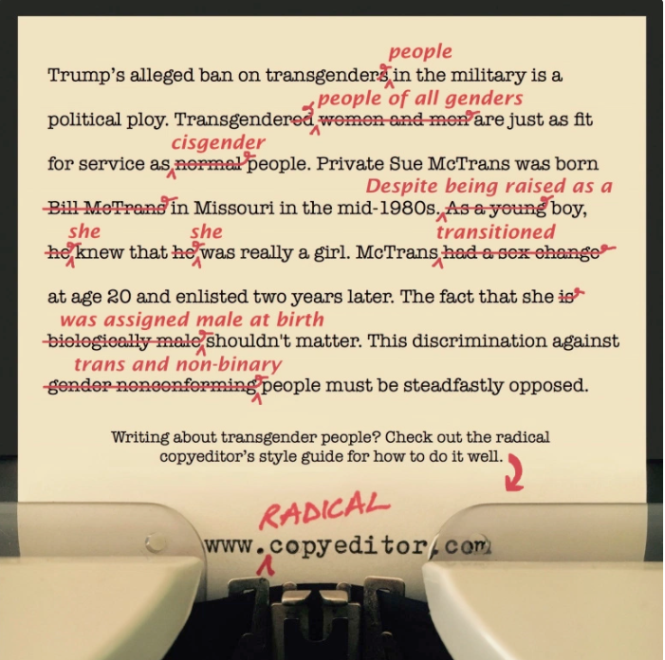

Slide 10
What do children know about gender?
Following data from Dr. Patrick Rock, Youth and Gender Project
Infants develop gender categories (male, female) by 6-9 months
When hear a man’s voice, preferentially look to a man’s face (over a woman’s face)
NOT a mature understanding of what these categories mean, but rather just an early recognition of patterns in their environment
By age 2, toddlers have learned rudimentary gender stereotypes
Express surprise by “mismatches,” e.g., an image of a man putting on lipstick
Can identify “boy toys” and “girl toys” according to typical social norms
By preschool, children start to avoid peers who violate gender norms

Slide 11
When do children develop a gender identity of their own?
Following data from Dr. Patrick Rock, Youth and Gender Project
Gender Identity: Children start to label themselves (e.g., as a boy, as a girl) between 2 and 3 years of age
Gender Stability: Between 3 and 4 years old, children learn that gender is stable—that a girl will not grow up to be a man.
Gender Constancy: Between 5 and 7 years old, children learn that gender is consistent across situations—that a boy does not become a girl by putting on a dress.
Over the course of early childhood, children seek out information about what being a “boy” or a “girl” means—looking to same-sex role models and media images.

Slide 12
What sort of gender variability is common in children?
Following data from Dr. Patrick Rock, Youth and Gender Project
Some children engage in play or hobbies that are not normative for their gender group
Some children are perceived as “gender non-conforming” in the way they walk, speak or play
Some children engage in pretend play in which they take on the role of a different-gendered character
Some children show delays in development of gender concepts (e.g., gender stability)
Research on children who engage in the above “gender atypical behaviors” reveals that the vast majority of such children do not grow up to identify as transgender.

Slide 13
What does it mean to be a transgender youth?
Following data from Dr. Patrick Rock, Youth and Gender Project
A child is considered transgender if they express a consistent, persistent and insistent gender identity that does not align with their assigned sex at birth.
Consistent: The child reliably claims the same gender identity
Persistent: These expressions of gender identity continue over a considerable time in the child’s life (6+ months)
Insistent: The child expresses their true gender identity resolutely or intensely
Youth who express these characteristics often grow up to be transgender adults
But…many transgender adults did not meet these criteria as children

Slide 14
Let’s Practice
I have a few different scenarios
We will break into groups and you will discuss how you would handle your scenario.
We will come back to together to discuss and go over best practices.

Slide 15
This summer you have a new camper in one of your second grade bunks named Noah. This child dresses in clothing typical of boys and expresses an interest in the same types of activities that the boys like.
After arriving at camp, while waiting for the rest of the campers, Noah sits and plays with the boys and generally seems to have more in common with them.
Noah was assigned female at birth, but the other campers clearly are interacting with Noah as a boy.
When it comes time to go to their cabins to unpack, Noah walks towards her assigned cabin in the girls’ side of the section. One of the boys asks Noah, “Where are you going?” Noah replies, “To my cabin.” The boy says, “The boys’ cabins are this way.” Noah doesn’t hear and continues following the girls.

Slide 16
A counselor working with the youngest age group (8-10 year olds) comes to you to tell you about one of the boys in his cabin, Joey.
Joey brought his favorite stuffed animal to camp and won’t go to sleep without it. It’s an old faded, pink bear that he’s obviously been carrying around with him everywhere. The counselor has convinced him to leave it in the cabin so it doesn’t get lost or destroyed at camp but the other kids have certainly noticed the teddy bear, along with some of Joey’s other behaviors, including his penchant for dressing up, drama and a wild imagination that involves lots of fairy princesses and damsels in distress being rescued by valiant young knights.
When given the chance, Joey casts himself in the role of princess or damsel unless there is a girl present eager to do it. The other kids are good kids but are definitely finding Joey’s behavior odd and are starting to snicker, comment and point behind his back.
You’re worried the teasing will become more direct and hurtful for Joey if he doesn’t start to act like the other boys.

Slide 17
16 year-old Chava is a young trans woman who moved to town at the end of the school year and didn’t have an easy transition into her new school. Not wanting another year of things not going well for Chava, her parents decided that instead of sending her back to her old camp, she should attend the local camp with her classmates and convince you – the Director – to let her into the Counselor in Training program without giving you much background.
In the first days of camp you can see what led to the slow transition. The other kids in the CIT program tease Chava about being a boy and use masculine gender pronouns when referring to her.
You’re feeling a little ambushed by her parents and very concerned about her as well as the other CITs who are supposed to be focused on learning how to become staff members/leaders at your camp.

Slide 18
After participating in a village-wide shira/rikud (song/dance), you overhear one of the campers say to another: ‘that was so gay!’. They both roll their eyes and continue to criticize the shira/rikud.

Slide 19
The camp season is over and you are celebrating a really great summer! While it had its usual bumps along the way, it was an overall really successful summer. You had been working on LGBTQ inclusion at your camp, trying to make sure it was a safe atmosphere and you feel like you largely succeeded.
The few queer staff that you had reported to you throughout the summer that a few of their campers had noticed the safe zone stickers around, that the staff were talking more openly about their identity, and that had made them feel safe to open up about some of their own struggles around their gender identity. Since camp was away from their parents, they wanted to use the time to explore themselves, and was so happy that camp was a place to embrace that. Eventually, one of the campers in the girls cabin got comfortable enough with their cabinmates that they came out to them as genderqueer, which everyone reacted greeted with love and support. Throughout the summer they all talked openly about gender and other identity issues.
Now that the summer is over, you start going through the evaluations and notice a note from a parent indicating she was displeased to hear from her daughter that their was a trans person in her daughters bunk without her being notified. She said that she was disappointing in the camp since this was a confusing situation for her daughter.

Slide 20
Debunking Myths About Transgender Inclusion in Athletics^{[1]}
Myth: Transgender boys and girls are not “real” boys and girls.
Fact: The gender identity of transgender individuals is as deep-seated as that of their cisgender peers. The characteristics of someone’s body DO NOT define someone’s gender identity.
Myth: Athletes will use trans-inclusive policies to gain a competitive edge.
Fact: There has never been an issue of individuals “pretending” to identify as a boy or a girl in order to gain a so-called competitive advantage or to deny participation of other athletes.
Myth: Allowing transgender girls onto girls teams would pose a safety risk for cisgender girls.
Fact: There are large overlaps in height, weight, and strength amongst cisgender boys and girls, and they compete against each other and on the same teams every day. There would be no additional safety risk when transgender youth participate on those same teams.
Myth: Allowing transgender girls onto girls teams will call into question the “competitive equity” of athletic competition.
Fact: There is no research that supports the myth that allowing trans athletes onto teams that are affirmative of their gender identity creates a competitive imbalance. Concerns about “competitive equity” perpetuate a gender stereotype that assumes individuals with male bodies outperform individuals with female bodies.

Slide 21
-You can’t tell if someone is transgender just by looking at them
-Don't make assumptions about a transgender person's sexual orientation.
-If you don't know what pronouns to use, listen first.
-Don't ask a transgender person what their "real name" is.
-Understand the differences between "coming out" as lesbian, bisexual, or gay and "coming out" as transgender.
-Be careful about confidentiality, disclosure, and "outing." -Respect the terminology a transgender person uses to describe their identity.
-Be patient with a person who is questioning or exploring their gender identity.
-Understand there is no "right" or "wrong" way to transition - and that it is different for every person.
-Don't ask about a transgender person's genitals, surgical status, or sex life.
-Avoid backhanded compliments or "helpful" tips.
http://www.glaad.org/transgender/allies

Slide 22
Addressing transphobic language:
As adults, you help set the tone. If you hear any slurs related to someone’s sexual orientation or gender identity, even if they don’t identify with that identity or you don’t know, you need to address it in the moment.
An appropriate response could be “In this community we treat each other with respect and that word is offensive and disrespectful”. Follow up with both the target of the slur and the one who used it.
Inappropriate or offensive language related to sexual orientation and gender identity could include, “f*ggot, tr*nny, he/she, it, d*ke, that’s so gay, etc”.
Statements such as “that’s a girl thing”, or ‘she must be a lesbian because she plays softball” are stereotypes that hurt all of us, regardless of identity. Assuming all girls and boys have penises and vaginas would also be transphobic language, as we know this to not be true.

Slide 23
Inclusion Guide for Camps

Slide 24
Contact:
Ami Altzman, ami@keshtonline.org
https://www.keshetonline.org/teenshabbaton/

Slide 25
Questions?
daniel@keshetonline.org
www.keshetonline.org

