Slide 1
#coronavirus + Camp
IMPACT OF CORONAVIRUS (“CV”) AND OTHER LEGAL ISSUES AROUND SUMMER CAMP SEASON
March16, 2020

Slide 2
Robert Deutsch, PA 75 NORTH MARKET STREET ASHEVILLE, NORTH CAROLINA 28801 828-251-0600 x12 bob@dglawpa.com

Slide 3
SHORT TERM (60 days)
What to know over the next 60 days

Slide 4
CV is “novel” dangerous virus:
No vaccine, treatment
Limited experience dealing with these viruses
Transmits easily/highly communicable
Unclear if the summer will make it “go away”
Friday, a Federal National Emergency was declared after most states declared state emergencies:
Enacts the Force of law
Purpose of declarations is to activate authorities and resources not available in non-emergencies
Government has broad authority to regulate conduct, businesses, travel
Scary to camps (might be closed like events), parents, campers, and staff

Slide 5
Contractual issues
Camper, staff enrollment agreements re: cancellation provisions
vendor agreements re: important dates, force majeure provisions
Definition/scope of force majeure provisions
Notice periods
Mitigation requirements
Business relationships – supply chain issues
Impossibility
Equipment/real property leases – term, options to renew, force majeure
Loan documents – abatement, interest only
Pre-camp/post-camp group contracts – force majeure provisions
Insurance policies – business interruption coverage – generally thought that communicable diseases don’t trigger coverage, but how about declarations of national and state emergencies? Impossibility?
Airlines, buses – federal regulation
All businesses will have supply chain issues
creative negotiation strategies
credits, postponement, donation model

Slide 6
Personnel issues
Staff:
International staff
Training
binding commitments (staff/camp)
Travel/ travel limitations/travel ban/ reduced flights
Early staff arrivals
Testing, affidavits
Immigration: J-1 exchange visas, H1B visas
Campers:
Cancellations/refunds of tuition
Lines of credit to deal with cash flow issues from refunds
Special arrangements for health factors
Travel issues (see above), charters
Recruiting for 2020
Communications to families

Slide 7
Long Term (Summer camp season)
Assuming Camp season takes place, preparations before season begins

Slide 8
Health considerations
Affidavits of travel for parents
Custodial issues – health care agent
Set up protocols for entrance into camp and at camp
Connect with local health dept and review protocols

Slide 9
Contractual Concerns
Amendment to camper, staff agreement release language – protocol for notice to parents
Amendment to force majeure provision in vendor contracts
Cancellation or reduction of order provision
Travel arrangements for early departure of campers or staff
Refund of tuition policy

Slide 10
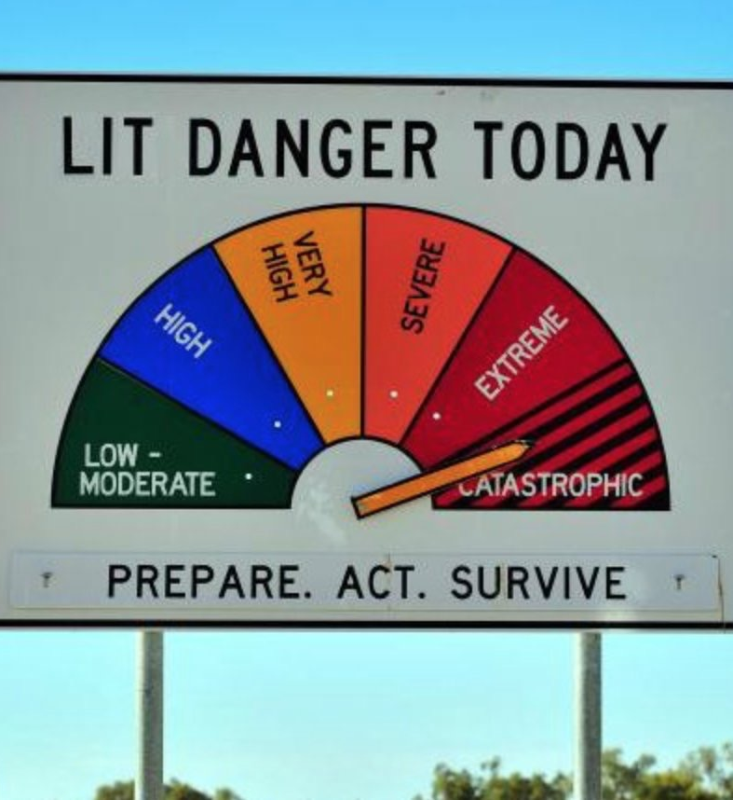
Worst-case scenario
Check with insurance company for coverage – special rider?
Relationship with local hospitals, supplemental health providers
PR
Travel arrangements

Slide 11
Potential sources of liability
Negligence resulting from communication of CV
Violation of standard of care/policy
Violation of health code/emergency declarations
Contractual liability from cancellation of orders/services
In loco parentis obligations

Slide 12
Questions?
I will gladly answer questions by email, without charge, for any organization who registered for Leaders Assembly
828-251-0600 x12 bob@dglawpa.com

Slide 13
Thank you

