Slide 2
storyMAKER: heart of the story
Presented by Miriam Brosseau
Principal, Tiny Windows Consulting

Slide 3
Hi there!
I’m Miriam.
I help Jewish organizations make the world a kinder, braver, more curious place through asking bigger questions and telling smaller stories.
Here’s my story.

Slide 4
Here’s what’s on the docket:
The Why of Storytelling
The How (Workshop!)
storyMAKER checklist
Interviewing to get at the story
Telling a smaller story
Editing for impact
The What - Storytelling in Practice

Slide 5
Challenge! Agenda as Story.
Pretend it’s two hours from now, and our session is done.
Rewrite our agenda for today as a first-person reflection on what happened.
Go!

Slide 6
What happened? What can we learn about storytelling from this exercise?
Stories are memorable.
Hey, what’s the last thing we’re going to do on this webinar?
Stories are designed to stick in our brains like no other kind of content.
Constraints set you free.
Did anyone battle a mythical beast? Or set their narrative on Mars? Or end up winning the lottery?
Was anyone really outrageous and creative in their storytelling?
No? Why not? Too. Much. Freedom.
Set more boundaries, get more creative storytelling.

Slide 7
Why tell stories?

Slide 8
Simple.
Marketing is about earning attention
and building trust.
Storytelling does both (and a lot more).
(But we don’t have time for the lot more.)

Slide 9
Be a storyMAKER
checklist
Ask:
Does this story Matter?
Is it Actionable?
Is it Kosher?
Is it Emotional?
Is it Readable?

Slide 10
storyMAKER checklist, the sequel
Matter: Will my audience care? Can they see themselves in this story? Does it help advance the mission?
Actionable: What do I want my audience to DO with this story? How will they know to do it? Does the action line up with the message of the story?
Kosher: Do I have permission to tell this story? Am I representing these characters in a way they would want to represent themselves? Does it reflect our organization’s values (and brand) in process, form, and content?
Emotional: Stories that show emotion, evoke emotion. How do you want your audience to feel? Does the story bring that out?
Readable: Have you crossed your i’s and dotted your t’s? Does it fit the platform where you’re sharing it? Is it inclusive and accessible?

Slide 11
A story is an invitation,
not a presentation.
Don’t show off,
show what’s possible.

Slide 12
How does your organization help your audience
become the kind of person they want to be?
Your
Mission
Who Your Audience Aspires
to Be

Slide 13
The best marketing doesn’t feel like marketing.
Tom Fishburne,
aka “The Marketoonist”

Slide 14
Three Techniques
to get
to the
heart
of the story.

Slide 15
Interviewing

Slide 16
Start with
genuine curiosity.
Don’t ask a question if you don’t care what the answer is.

Slide 17
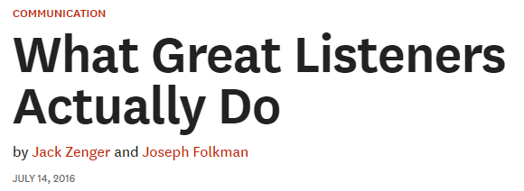
Not (just):
Listening silently
Facial and verbal recognition
Verbatim repetition
Rather:
Periodically ask questions to promote discovery & insight
Include interactions that build the teller’s self-esteem
Constructively challenge assumptions
Promote continuous flow, not competing for airtime

Slide 18
In the best interviews, BOTH of you walk away with new insight.

Slide 19
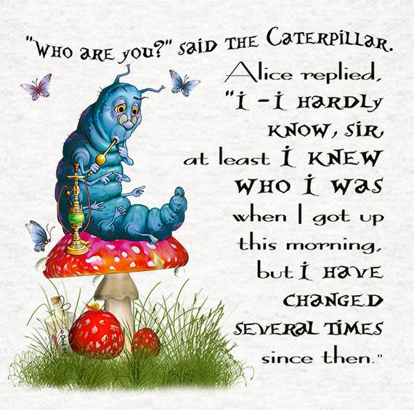
Ask questions that invite storytelling.

Slide 20
Smaller Stories

Slide 21
Get at the “why” without asking why.
Reframe “why” questions as “how” or “what.” “Why” demands a reason. “How” invites a narrative.
What led you to…?
How did you first come to…?
What drives your interest in…?
How did that influence your decision to…?

Slide 22
Ask about emotion and spark good feeling.
Stories that show emotion, evoke emotion. So don’t be afraid to just ask! If the interviewee feels good around you, they’ll open up more, and feel more connected to the piece and the organization.
How did that make you feel? Or: What was that like? Add specificity.
What makes/made you smile about…?
What are/were you most proud of…?
What surprised you about…?

Slide 23
Get at the transformation.
Stories need three things: character (who’s driving the action, what do they want?), conflict (what stood in the way?), and conclusion (how did it turn out? The transformation).
Ask questions that help your interviewee get at the smallest possible moment that captures the conclusion/transformation - that’s your impact!
When did you know…?
What was your favorite moment from…?
What did you learn from…?
Tell me about a time when…?

Slide 24
Let’s hear from you!
In your experience, what interview questions have worked best at eliciting storytelling? Share in the chat.

Slide 25
Editing for Impact

Slide 26
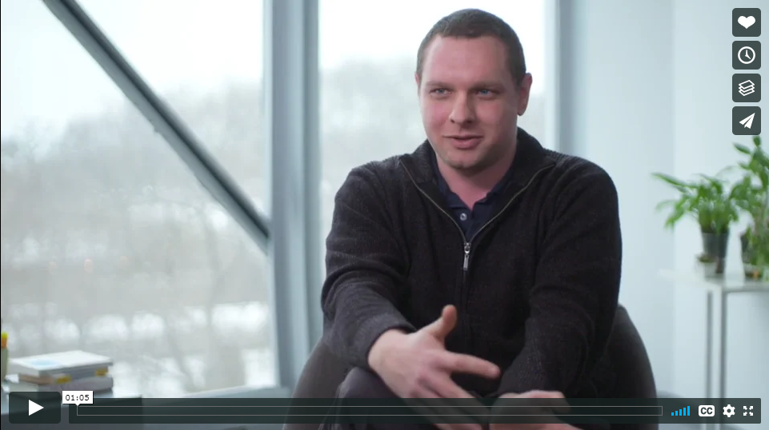
Editing for Impact

Slide 27
Three Key Elements
Character
Who is driving the action?
Help me relate.
Conflict
What does the character want, and what’s standing in the way?
Transformation
What was the resolution or impact?
What role did camp - the place, the staff, the experience - play in making that transformation possible?
Camp is the Setting. Staff are the Mentors.
The camp may be awesome. But that’s not the point. The point is the awesome it brings out in its campers - and everyone touched by the mission. Show the real hero of the story.

Slide 28
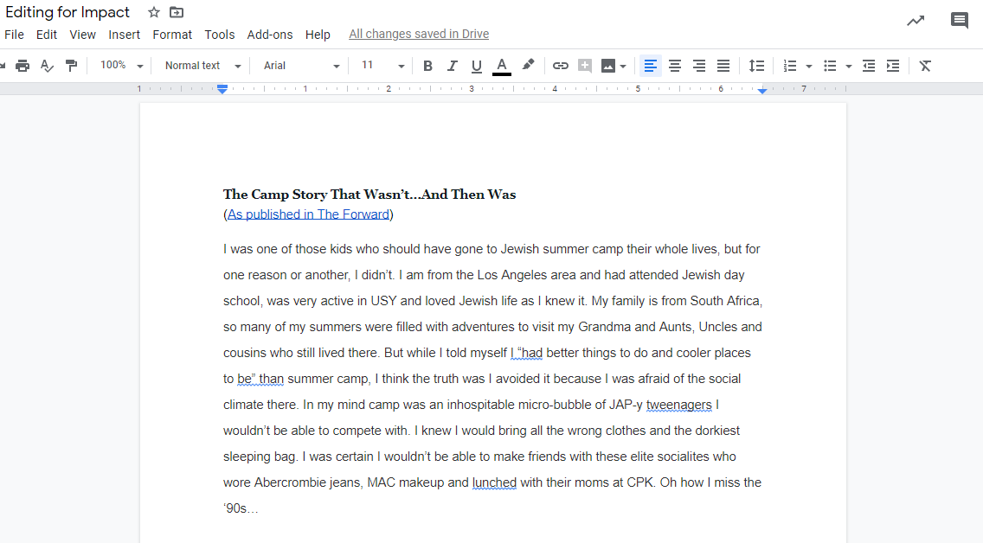
Editing for Impact
Notes:
Share the link to the doc in the chat: https://docs.google.com/document/d/1dSx-A85gUulUDKt_7GnKBsy2ggonRt1Ei6BwYqoBj5I/edit#
Share the link to the submission form in the chat: https://forms.gle/9CbKhaCbvrrCwBus7

Slide 29
Closing thoughts?

Slide 30
Thank You!
Hey. I’d love to hear your story.
miriam@tinywindowsconsulting.com

